Slide 1
Introduction to Isuzu Online Training

Slide 2
Go to http://isuzutraining.com/ New Users: All new users will receive an email very shortly with your user login information. Go to http://isuzutraining.com to login. Your company email address is your username and your temporary password is 12345 Preexisting Users: If you have already previously completed some of your training on http://isuzutraining.com then all you will need to do is login and complete the assigned training modules. Password Reset: If you have forgotten your password please email crf@ltr.com and request a password reset.

Slide 3
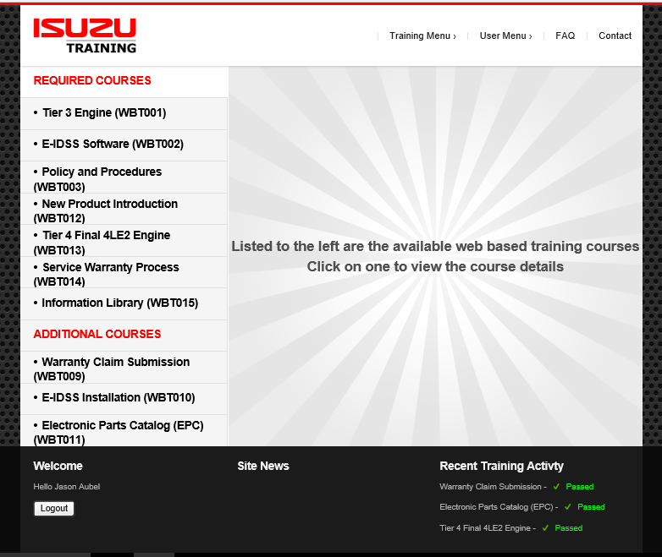
Once you have logged on:
From the Training Menu you can choose:
Web Based Training

Slide 4
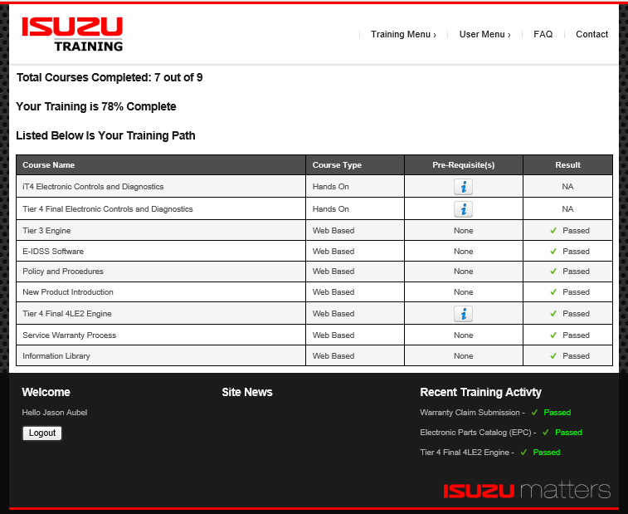
Once you have logged on:
From the Training Menu you can check your progress by choosing:
Training Path

Slide 5
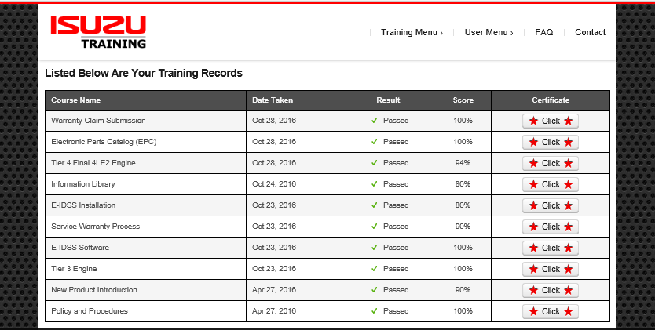
Once you have logged on:
From the Training Menu you can download your certificates by choosing:
Training Records

Slide 6
QUESTIONS????

